Slide 1
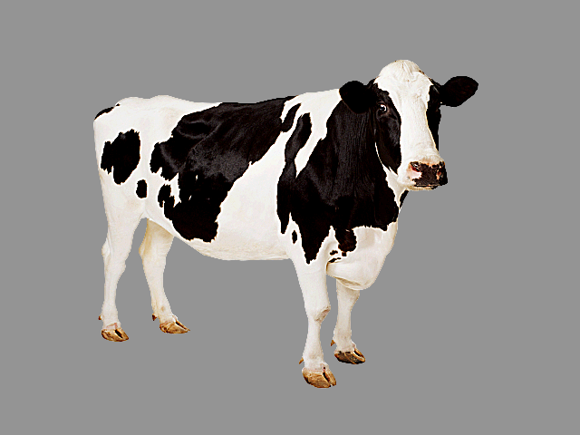
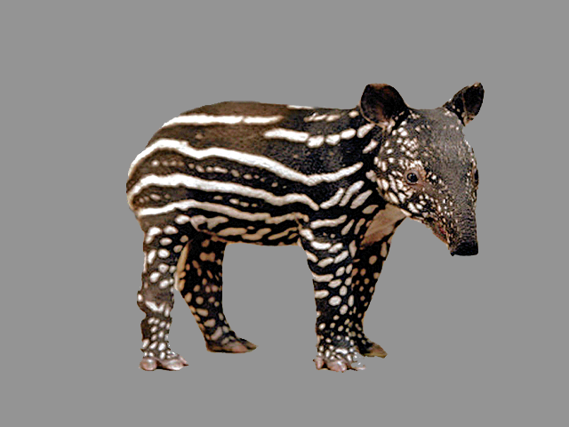
One-to-one biases in a non-linguistic and non-communicative domain:
30-month-olds map novel animal vocalizations to unfamiliar animals
Ricardo A.H. Bion
Kyle MacDonald
Anne Fernald
Stanford University

Slide 2
Why do children chose a novel object when hearing a novel word?
Lexical-specific constraints
de Marchena et al., 2011
Inferences about speakers' communicative intentions
Bloom, 2002; Diesendruck & Markson, 2001
Domain-general learning principles
Regier 2003; Frank, Goodman, Tenenbaum 2009; McMurray et al., 2011
Notes:
During the last 35 years, several studies have shown that children chose a novel object as the referent for a novel word
This disambiguation bias has been characterized as motivated by lexical specific constraints, inferences about speakers' communicative intentions, and more recently as the result of domain-general learning principles that looks for regularities in complex learning tasks.
The goal of our research is NOT to reject the first two possibilities, but to explore the strengths of a domain-general mechanism, testing for disambiguation for nonlinguistic and noncommunicative stimuli.

Slide 3
Are words special for infants?
Words but not tones promote object categorization and individuation in young infants (Fulkerson & Waxman, 2007; Xu, 2002)
Younger infants accept many forms as object labels, but older infants seem to favor words
(Namy & Waxman, 1998; Woodward & Hoyne, 1999)
Infants prefer to hear words over some nonlinguistic analogues (Vouloumanos & Werker, 2004, 2007)
Notes:
Several studies have asked whether words are special for infants, finding advantages for speech over nonlinguistic analogues in categorization, individuation, crossmodal association, and speech preferences.

Slide 4
Are words special for infants?
Words but not tones promote object categorization and individuation in young infants (Fulkerson & Waxman, 2007; Xu, 2002)
Younger infants accept many forms as object labels, but older infants seem to favor words
(Namy & Waxman, 1998; Woodward & Hoyne, 1999)
Infants prefer to hear words over some nonlinguistic analogues (Vouloumanos & Werker, 2004, 2007)
z
Arbitrary nonlinguistic cues
Notes:
These studies focused on arbitrary nonlinguistic cues that are not consistently associated to objects in children's environments.

Slide 5
Are words special for humans?
Words and environmental sounds might be processed differently by adults (Chen & Spence, 2011)
15- and 25-mo-olds can use words and environmental sounds to guide their attention to familiar objects
(Cummings et al., 2009)
5-mo-olds can match some animals to their vocalizations (Vouloumanos & Werker, 2004, 2007)
Notes:
Other studies approached the question of whether speech is special from a different perspective, showing similarities and differences in the processing of words and other meaningful environmental sounds, such as animal vocalizations or the sounds that objects make.

Slide 6
Are words special for humans?
Words and environmental sounds might be processed differently by adults (Chen & Spence, 2011)
15- and 25-mo-olds can use words and environmental sounds to guide their attention to familiar objects
(Cummings et al., 2009)
5-mo-olds can match some animals to their vocalizations (Vouloumanos & Werker, 2004, 2007)
Meaningful associations
Notes:
We think that these meaningful associations provide an interesting set of stimuli to test for disambiguation in nonlinguistic domains.
We chose to focus on animal vocalizations because they are nonlinguistic sounds that are consistently associated to common objects in children's environments.

Slide 7
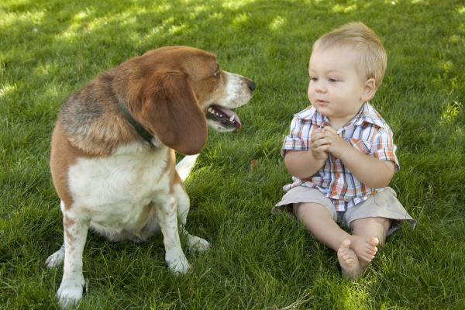
arbitrary
non-arbitrary
animal names
onomatopoeic words
animal vocalizations
look at the
bow-wow!
Woof!
where's the dog?
Notes:
While words are arbitrary associations between a sound and an object, animal vocalizations are non-arbitrary.
But they are both meaningful and consistent

Slide 8
arbitrary
non-arbitrary
animal names
onomatopoeic words
animal vocalizations
look at the
bow-wow!
Woof!
where's the dog?
Can 30-mo-olds use these three sounds
to identify a familiar animal?
Notes:
The first question we ask in this research is whether 30 month-olds could use familiar animal names, animal vocalizations, as well as onomatopoeic sounds, which falls somewhere in between names and vocalizations, to identify a familiar animal, and whether one of these three sounds is a particularly effective cue in guiding children's attention to an animal in their environment.

Slide 9
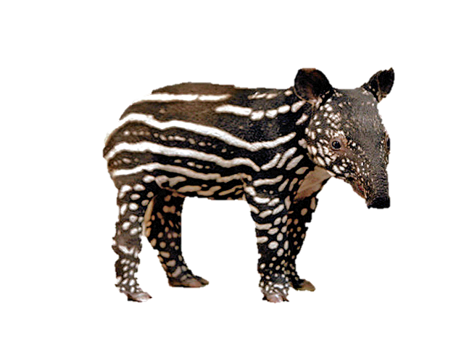
arbitrary
non-arbitrary
novel animal name
novel animal vocalization
novel vocalization
where's the nadu?
Notes:
And if we establish that young children can use a familiar vocalization to identify a familiar animal, we can ask how they would respond to a NOVEL animal vocalization in the presence of a familiar and a novel animal.
We expect from previous studies that if a child heard the novel name nadu in the presence of a familiar and a novel animal, that they would chose the novel animal.
The question that remains is how children would respond to a novel animal vocalization.

Slide 10
arbitrary
non-arbitrary
novel animal name
novel animal vocalization
novel vocalization
where's the nadu?
Do children choose a novel animal in response to a novel animal vocalization?
Notes:
Would they chose a novel animal if they heard a novel animal vocalization.

Slide 11
arbitrary
non-arbitrary
novel animal name
novel animal vocalization
novel vocalization
where's the nadu?
If so, do children actually remember the mapping between the novel animal and vocalization?
Notes:
And IF SO, would children actually remember the mapping between the animal and its vocalization.

Slide 12
STUDY 1
How quickly can 30-mo-olds use linguistic and non-linguistic cues to identify a familiar animal?
Do children choose a novel animal in response to a novel animal vocalization?
STUDY 2
If so, do children actually remember the mapping between the novel animal and vocalization?
Notes:
These are our three research questions, the first is about the processing of familiar animal names, onomatopoeic words, and animal vocalizations.
The second is about children's disambiguation biases for novel animal vocalization.
And the third is about children's memory for the links created through disambiguation.
STUDY 1 addresses the first two questions and STUDY 2 addresses the third question.

Slide 13
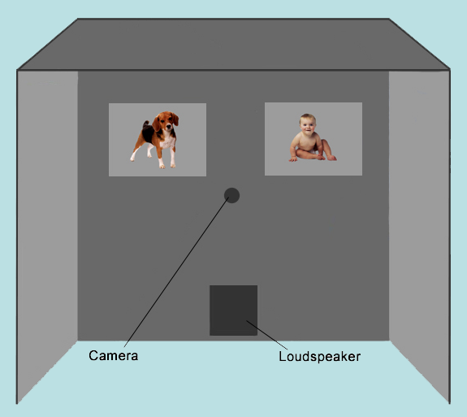
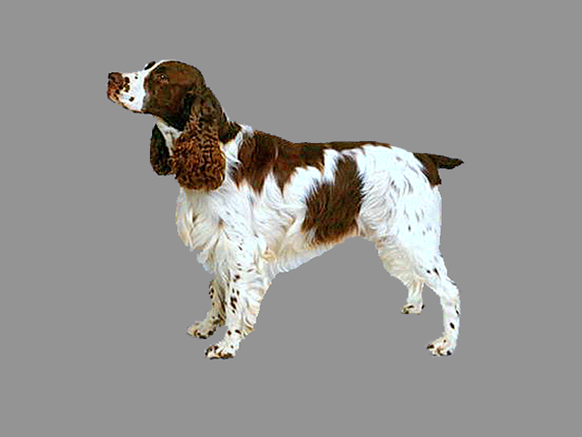
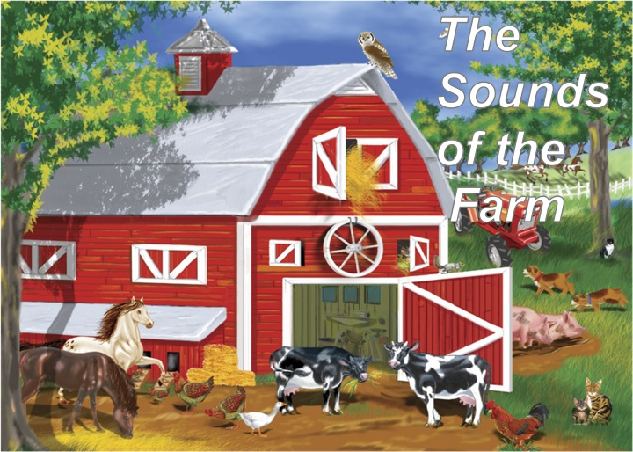
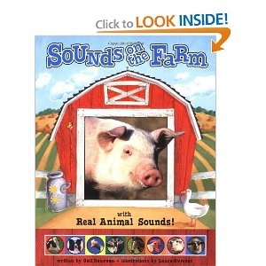
Study 1: DESIGN
21 30-mo-olds
2 Familiarization books
Looking-while-listening task
Accuracy:
Proportion looking to target
[300 to 4300 ms]
Reaction time:
Time to shift to target
[300 to 1800 ms]
Fernald et al. (2008)
Notes:
In study 1, we tested 21 30-month-olds
In order to make sure that children knew the sounds that our familiar animals made, we gave two books with audio about animal vocalizations to parents and encourage them to read these books to their children during the week prior to our study.
We then tested children in the looking while listening task. Children saw the pictures of two animals and heard either a familiar or a novel sound.
From children's looking patterns to the pictures of these two animals, we computed measures of accuracy and reaction time.

Slide 14
STUDY 1
How quickly can 30-mo-olds use linguistic and non-linguistic cues to identify a familiar animal?
Do children choose a novel animal in response to a novel animal vocalization?
STUDY 2
If so, do children actually remember the mapping between the novel animal and vocalization?
Notes:
In order to address our first question looking at children's processing of familiar sounds, we tested children on three different familiar sounds.

Slide 15

Study 1 STIMULI: Familiar-sound
3 TRIAL TYPES
8 ANIMAL-NAME
Look at the dog
8 ONOMATOPOEIC-WORD
Which one goes woof-woof?
16 ANIMAL VOCALIZATION
Listen [dog barking]
horse-dog-cow-sheep
Notes:
Children saw the picture of two familiar animals, and heard an animal name [ let me play that sound to you - PLAY], an onomatopoeic word [PLAY], or an animal vocalization [PLAY].

Slide 16
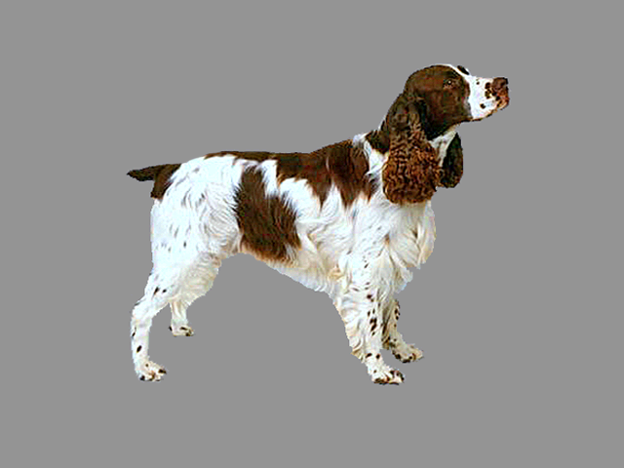
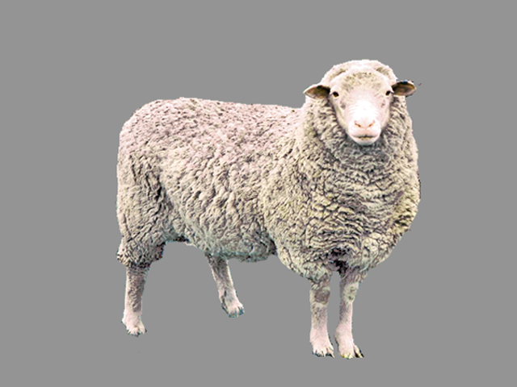
30-mo-olds responded fastest to the familiar animal name and slowest to the familiar animal vocalization
D O G
name
onomatopoeic word
W O O F
animal vocalization
[barking]
Time (ms) from sound onset
Notes:
And these are our results.
On the x axis you see, and on the y axis you see proportion shifting to target.
I am showing here children's responses only during the trials in which they were looking at the distractor animal at sound onset.
Children were fastest to orient to…

Slide 17
30-mo-olds responded fastest to the familiar animal name and slowest to the familiar animal vocalization
D O G
name
Why?
• Frequency
• Design features
• Representational
differences
onomatopoeic word
W O O F
animal vocalization
[barking]
Time (ms) from sound onset
Notes:
But why did children respond faster for words than for animal vocalizations. There are at least three possible explanations.
The first might be differences in frequency between words and vocalizations. Children have heard the word cow many more times than they have heard an actual cow mooing.
The second might be design features of speech. Speech is very effective at presenting a lot of information in a short period of time. When a dog and a sheep are paired with each other
And the third might be differences in the representation of speech and vocalizations. Words and vocalizations might be processed by different brain regions, and words refer to objects while animal vocalizations are causally connected to objects.

Slide 18
30-mo-olds responded fastest to the familiar animal name and slowest to the familiar animal vocalization
D O G
name
onomatopoeic word
W O O F
animal vocalization
[barking]
Time (ms) from sound onset
Notes:
We have shown this advantage for speech in RT, but when we look over a longer window of accuracy.

Slide 19
Over a 4-s response window, all 3 Familiar sounds were equally effective in drawing children’s attention to a Familiar target animal
NAME ONOMATOPOEIC VOCALIZATION
WORD
Notes:
All 3 familiar sounds were equally effective in drawing children's attention to a familiar animal.

Slide 20
STUDY 1
How quickly can 30-mo-olds use linguistic and non-linguistic cues to identify a familiar animal?
Do children choose a novel animal in response to a novel animal vocalization?
STUDY 2
If so, do children actually remember the mapping between the novel animal and vocalization?
Notes:
Now that we established that children can use nonlinguistic sounds to draw their attention to a familiar animal, we can focus on the second question and ask whether they would chose a novel animal in response to a novel vocalization.

Slide 21
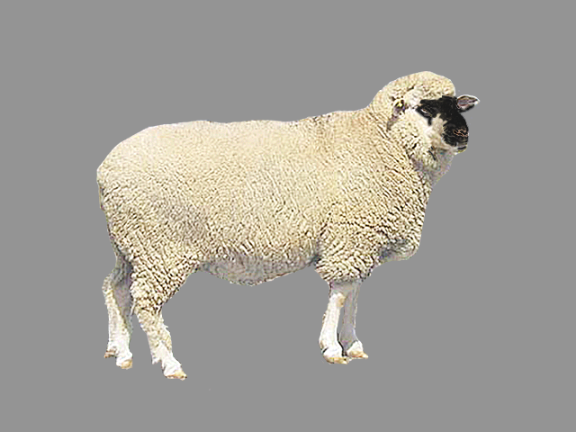
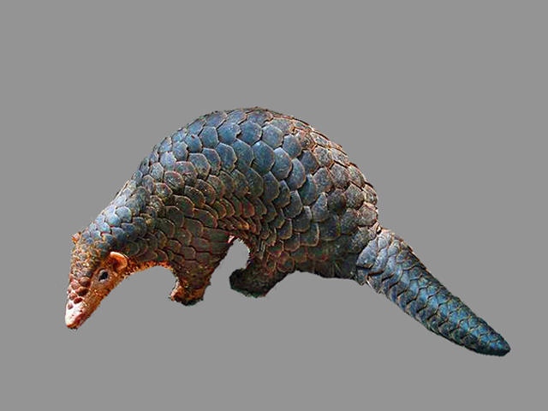
Study 1 STIMULI: Disambiguation
2 TRIAL TYPES
6 NOVEL-NAME
Where’s the nadu/capa?
8 NOVEL-VOCALIZATION
Listen [novel vocalization]
Novel animals: tapir and pangolin
Novel vocalizations: rhino grunting and gorilla snorting
Notes:
For these disambiguation trials, children heard a novel name or a novel animal vocalization and saw the picture of a familiar and a novel animal.
The familiar animals were the same as the ones on the familiar sound trials, and the novel animals were a tapir and a pangolin, two mammals encountered in Asia but not in north America.
The animals were of similar size and did not have strong affordances that children could use for disambiguation.
The novel names were nadu and capa [let me play that to you PLAY], and the the novel vocalizations were produced by a rhino and by a gorilla. And this is how they sounded [PLAY] [PLAY]. The vocalizations and animals were all counterbalanced.

Slide 22

Children chose the Novel animal when hearing a Novel animal name OR a Novel vocalization
% Looking to novel animal
NOVEL NOVEL
NAME VOCALIZATION
Notes:
And these are our results.
Children looked at a novel animal when hearing a novel name and animal vocalization, with no different between their processing of the two novel sounds.

Slide 23
Children chose the Novel animal when hearing a Novel animal name OR a Novel vocalization
% Looking to novel animal
NOVEL
NAME
NOVEL
VOCALIZATION
FAMILIAR
NAME
FAMILIAR
VOCALIZATION
Notes:
And these are our results.
Children looked at a novel animal when hearing a novel name and animal vocalization, with no different between their processing of the two novel sounds.

Slide 24
Children chose the Novel animal when hearing a Novel animal name OR a Novel vocalization
Disambiguation for stimuli other than words and facts
NOVEL NOVEL
NAME VOCALIZATION
Notes:
Children showed disambiguation biases for nonlinguistic and noncommunicative stimuli, suggesting that at least some patterns of disambiguation might be explained by domain general mechanisms

Slide 25
STUDY 1
How quickly can 30-mo-olds use linguistic and non-linguistic cues to identify a familiar animal?
Do children choose a novel animal in response to a novel animal vocalization?
STUDY 2
If so, do children actually remember the mapping between the novel animal and vocalization?
Notes:
We showed disambiguation for animal vocalizations, but recent studies started to emphasize the difference between disambiguation and learning.
So in our second study, we test whether children actually remember the mapping between a novel animal and vocalization.

Slide 26
STUDY 2: DESIGN
20 30-mo-olds
Same as STUDY 1
But only animal vocalizations
Fernald et al. (2008)
Notes:
The stimuli is the same as study 1, but we decided to focus only on animal vocalizations.

Slide 27
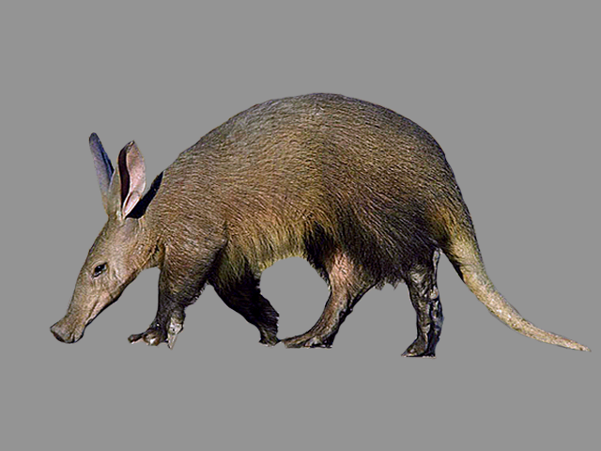
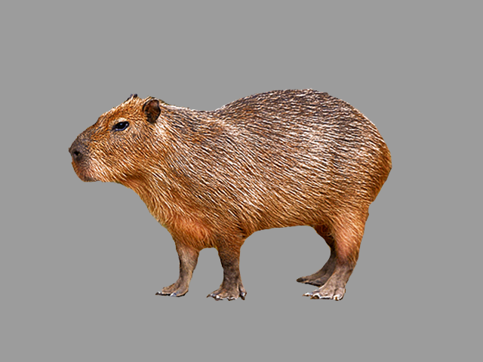
3 Trial types as in Bion, Borovsky, & Fernald (2012)
16 FAMILIAR-VOCALIZATION
8 DISAMBIGUATION
8 RETENTION
aardvark - capybara
Notes:
As in a recent study that we published on the relation between disambiguation and retention in early word learning, we had three trial types.
Familiar vocalization trials, in which children…
Disambiguation trials, in which children
And retention trials, in which we tested whether children remember the link between an animal and a vocalization created through disambiguation
In order to feel even more confident about the findings of study 1, we chose two different novel animals, an aardvark and a capybara.

Slide 28
On retention trials, children showed fragile evidence of remembering this mapping
FAMILIAR DISAMBIGUATION RETENTION
Target animal:
Distracter animal:
Familiar
Familiar
Novel
Familiar
Novel
Novel
Notes:
As in study 1, children looked at a familiar animal when hearing a familiar animal vocalization, they looked at a novel animal when hearing a novel animal vocalization, but as we previously found in early word learning, there was only fragile evidence of retention.

Slide 29
Children who did better on disambiguation did better on retention
r (18) = 0.44, p = 0.05
Notes:
Yet success on disambiguation was related to retention. On the x axis, I am showing disambiguation, on the y axis I am showing retention. And as you can see children who did better on disambiguation also were better at remembering the link.

Slide 30
Children who did better on disambiguation did better on retention
r (18) = 0.44, p = 0.05
r (18) = 0.44, p = 0.05
Disambiguation is related to retention but not necessarily sufficient
Notes:
This suggests that disambiguation is related but not necessarily sufficient to learning.

Slide 31
Is disambiguation motivated by a single mechanism?
Children show disambiguation for stimuli other than words and facts (Bion et al., Halberda)
Different mechanisms could jointly contribute to disambiguation behavior (Lewis & Frank, in press)
Notes:
The question that remains is whether the finding from our studies and from previous studies could be explained by a single disambiguation mechanism.
We showed that children can disambiguate stimuli other than words and facts, suggesting at least the existence of a domain general mechanism that leads to disambiguation. A preference for parsimony provides some week evidence in favor of a single mechanism.
But as pointed out by recent computational work, it Is possible that different mechanisms jointly contribute to disambiguation behavior, explaining findings across different populations and contexts.

Slide 32
Recent research on disambiguation
Role of experience
Byers-Heinlein & Werker; Fernald - SRCD 2011
Yurovsky, Smith, Bion, & Fernald; Weisleder et al. - SRCD 2013
Relation to word learning
Horst, Samuelson, McMurray; Bion, Borovsky, & Fernald - SRCD 2011
Scope
Samuelson; Halberda; Bion et al.; Suanda & Namy - SRCD 2013
Notes:
And to conclude, this study adds to a recent body of work that encourages us to think differently about disambiguation biases.
Byers Heinlein, Anne Fernald, and Dan Yurovsky showed that disambiguation biases are not robustly present across different populations
Larissa, Jessica Horst, and Bob McMurray, and our group at Stanford have shown that disambiguation biases should not be conflated with word learning.
And in this symposium we open a discussion about the scope of these biases.
I am excited to be a part of this debate, and I am looking forward to you comments.

Slide 33
Thank you!
Notes:
And there's a lot of people I would like to thank.

Slide 34
Acknowledgements
Virginia Marchman
Kat Adams
Nereyda Hurtado
RAs at the Center for Infant Studies
Children and parents who participated in this study
NIH grant to Anne Fernald (R01 DC008838)
Notes:
And there's a lot of people I would like to thank.

